Slide 1
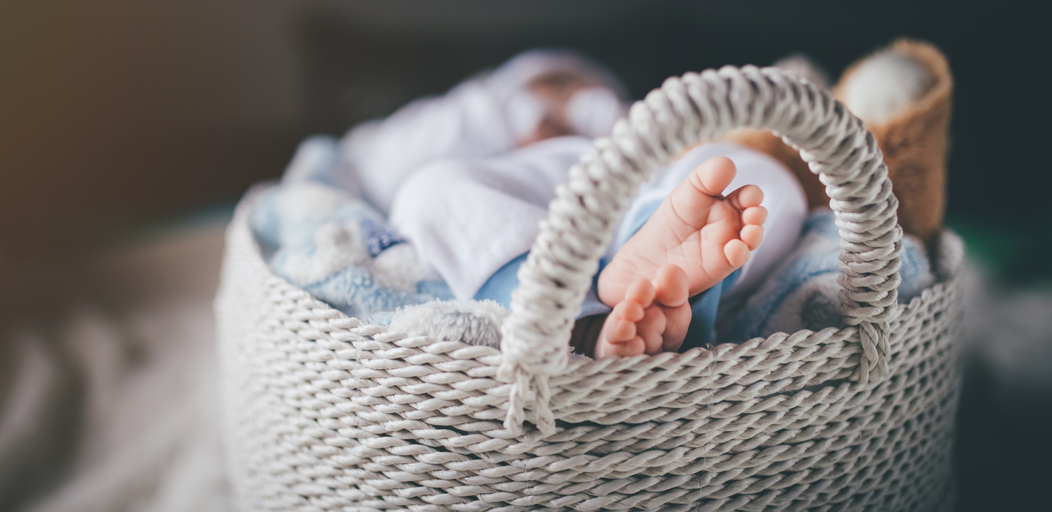
Noel Baskets – wish list items
Items that can be donated:
Baby diapers sizes newborn and size 1
Gently used (No stains please)baby clothes size 0-12 months
sleepers, onesies, shirts, pants etc.
Baby blankets
Baby bibs
Baby wipes
Baby wash
Baby booties/socks
Towels and washcloths (regular size)
Baby brush and comb
Wish list available on Amazon:
Search under Custom Gift list, last name Ranalli (Patty)
Children are a gift from the Lord; they are a reward from Him.
Psalm 127:3

